Slide 1
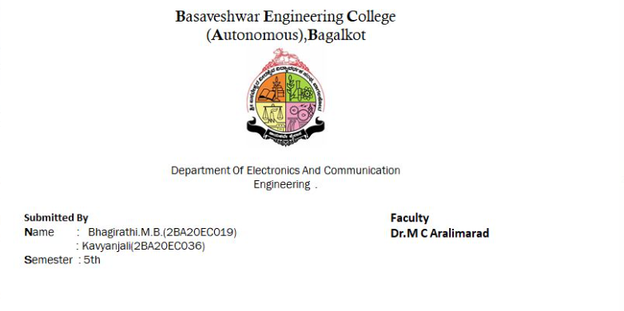

Slide 2
Aim of the Project
Design of Automated Teller Machine Controller

Slide 3
INTRODUCTION
The ATM will service one customer at a time.
A customer will be required to insert an ATM card and enter a personal identification number (PIN) - both of which will be sent to the bank for validation as part of each transaction.
The customer will then be able to perform one or more transactions.
The card will be retained in the machine until the customer indicates that he/she desires no further transactions, at which point it will be returned

Slide 4
Objectives of the Project
To review the literature for understanding the Automated Teller Machine Controller realization for RTL Modeling
To arrive at the design specifications for architecture based on reviewed literature for intended application
To design Verilog module for controller and perform behavioral simulation
To Synthesis the design using the FPGA flow and perform implementation

Slide 5
What is Automated Teller Machine
Definition.
ATM full form is Automated Teller Machine which is a self-service banking outlet.
You can withdraw money, check your balance, or even transfer funds.
Different banks provide their ATM services by installing cash machines in different parts of the country.

Slide 6
ADVANTAGES OF ATM
• Provide Convenience to Customers
• Offer 24×7 Service
Reduce Banks Workload
• Access to Bank Account from Anywhere
• Minimizes Transactions Cost

Slide 7
DISADVANTAGE
ATM use fees.
The inability to withdraw cash if an ATM is broken.
Potential for robbery.
Potential for having your PIN hijacked by criminals manipulating an ATM.

Slide 8
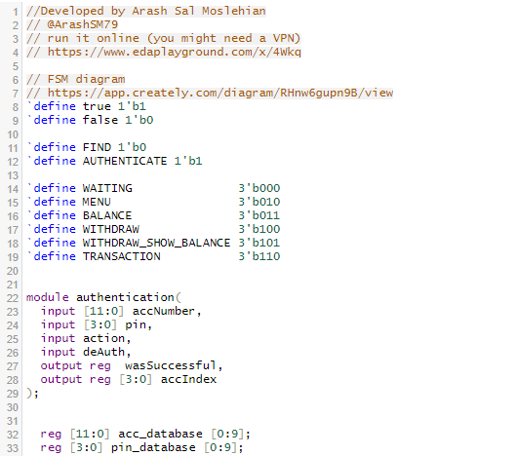
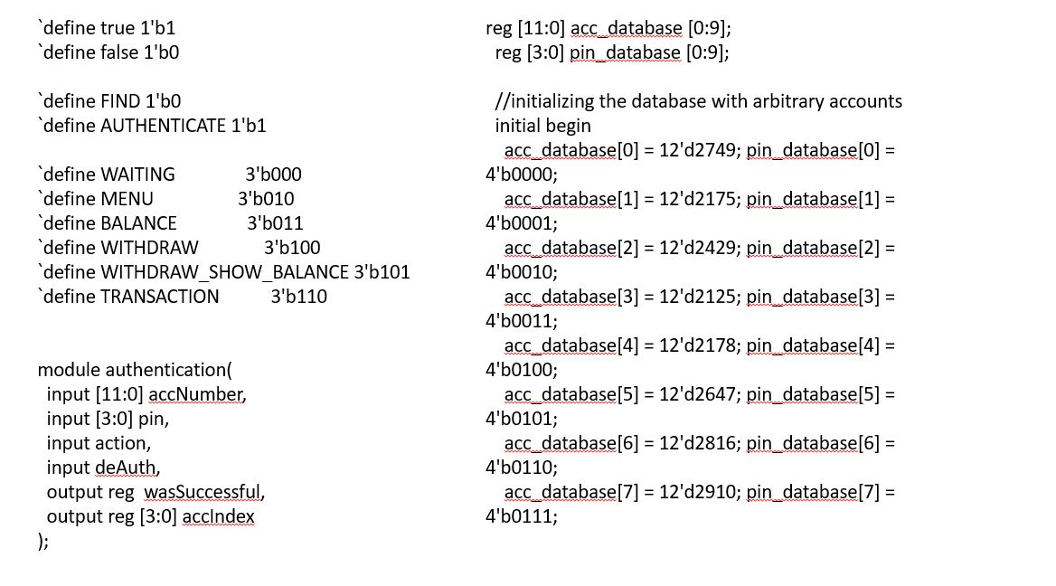
Verilog code

Slide 9
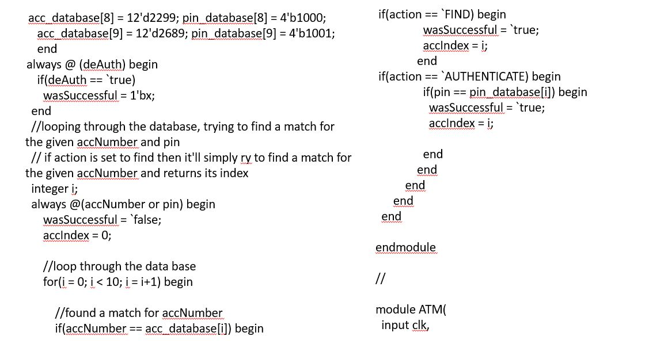
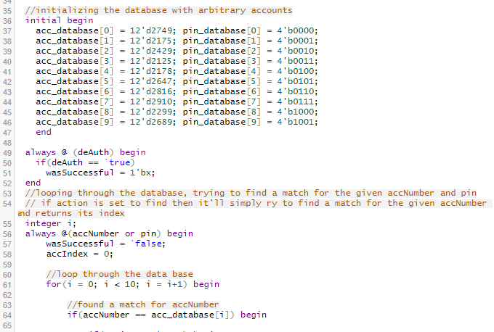

Slide 10
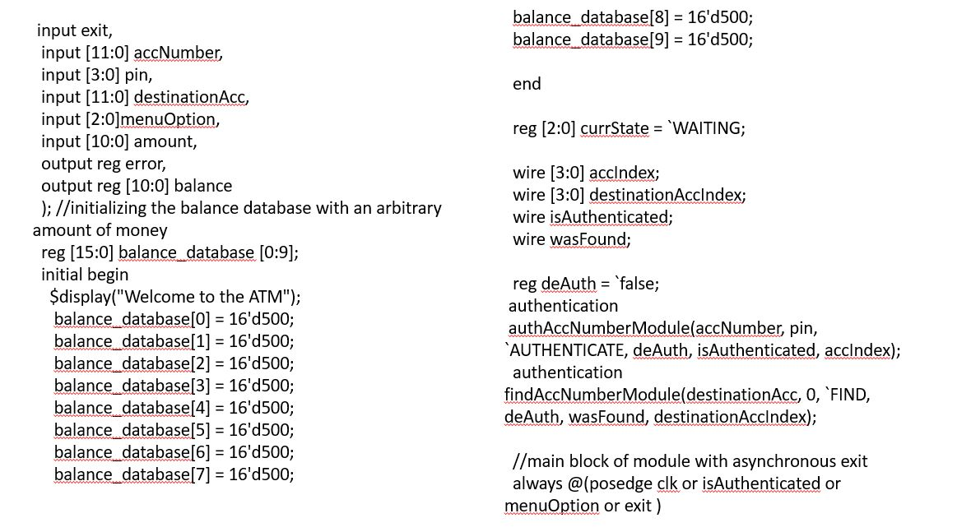
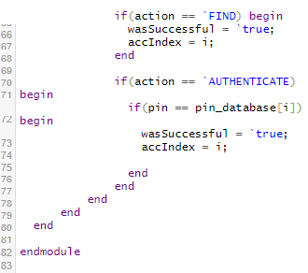

Slide 11
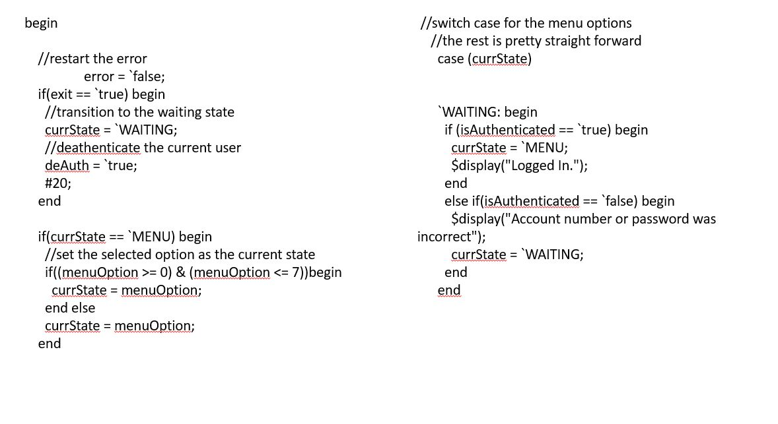
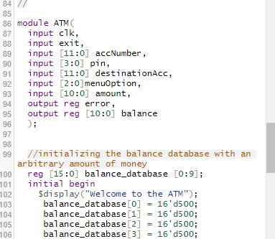

Slide 12
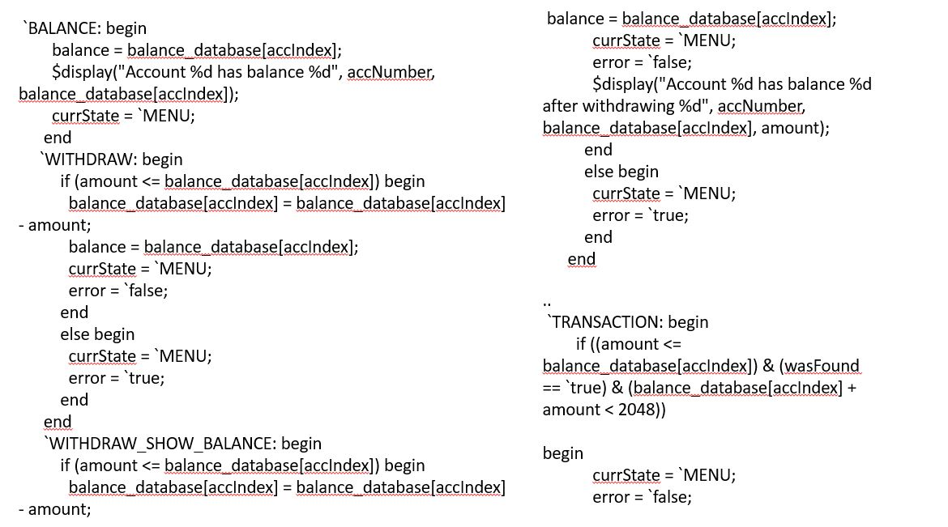
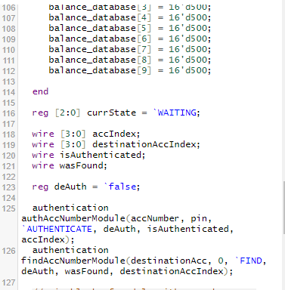

Slide 13
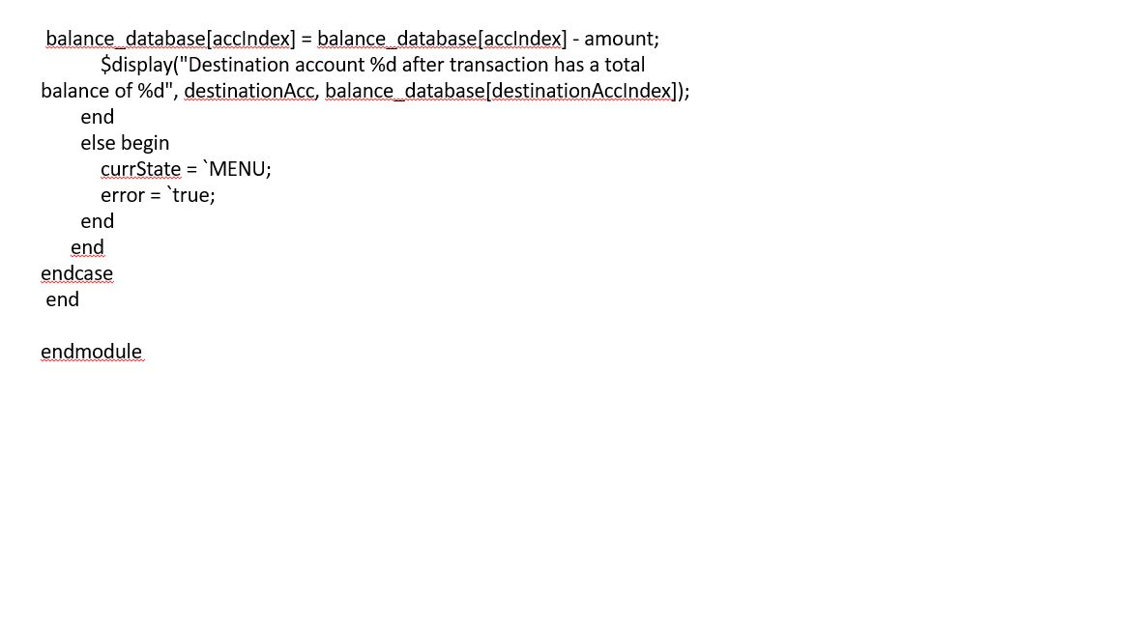
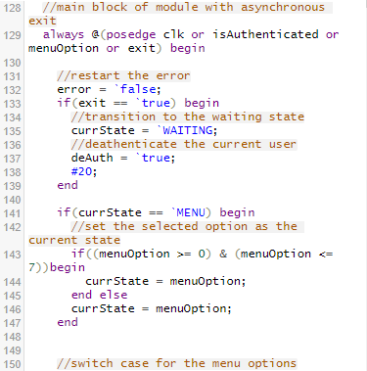

Slide 14
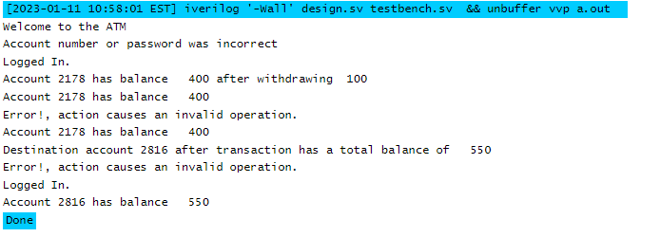
output

Slide 15
CONCLUSION
From this presentation, one can observe that an ATM system is associated with the bank transactions of the consumers.
Majorly, the ATM system is utilized for the money associated transactions from the consumers. Consumers make major use of ATM to withdraw money from their bank account.
It is a fast way to get money out of your account, especially when on the go or during a trip

